Slide 1
Marketing Presentation
M wajahat 20B-032-SE

Slide 2
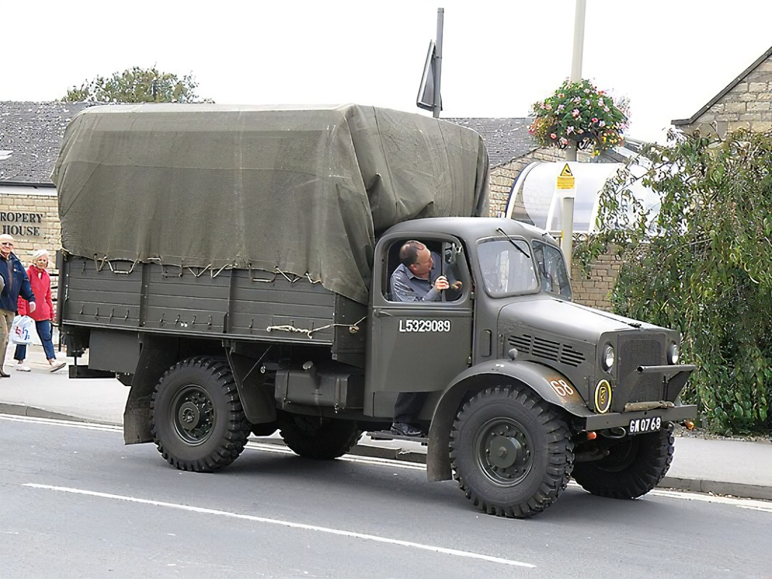
introduction
I'm proud to introduce our business, which has been a part of the trucking industry for over 30 years. We specialize in crafting high-quality air filters designed for Bedford trucks. Our journey began three decades ago with a commitment to delivering clean and efficient air solutions. Today, we stand as a trusted name in the industry, known for our dedication to excellence and the reliability of our products.

Slide 3
Mission Statement
Driven by our passion for clean and efficient air filtration, we've dedicated the past 30 years to crafting top-quality filters for special type Bedford trucks. Our mission is to keep drivers on the road safely and smoothly by providing the most reliable air filtration solutions in the industry. We take pride in our commitment to innovation, performance, and sustainability, ensuring that every journey is as fresh as it is efficient.
"Empowering Clean Air on the Road to Drive Excellence."

Slide 4
Objectives & goals
Quality Excellence: Continuously improve the quality of our air filters to exceed industry standards, ensuring optimal performance and customer satisfaction.
Market Expansion: Expand our market reach by identifying and entering new geographical regions and customer segments, increasing our customer base and revenue.
Becoming a Brand: Objective: To establish our OEM manufacturing business as a distinguished and trusted brand in the air filtration industry, known for quality and innovation.

Slide 5
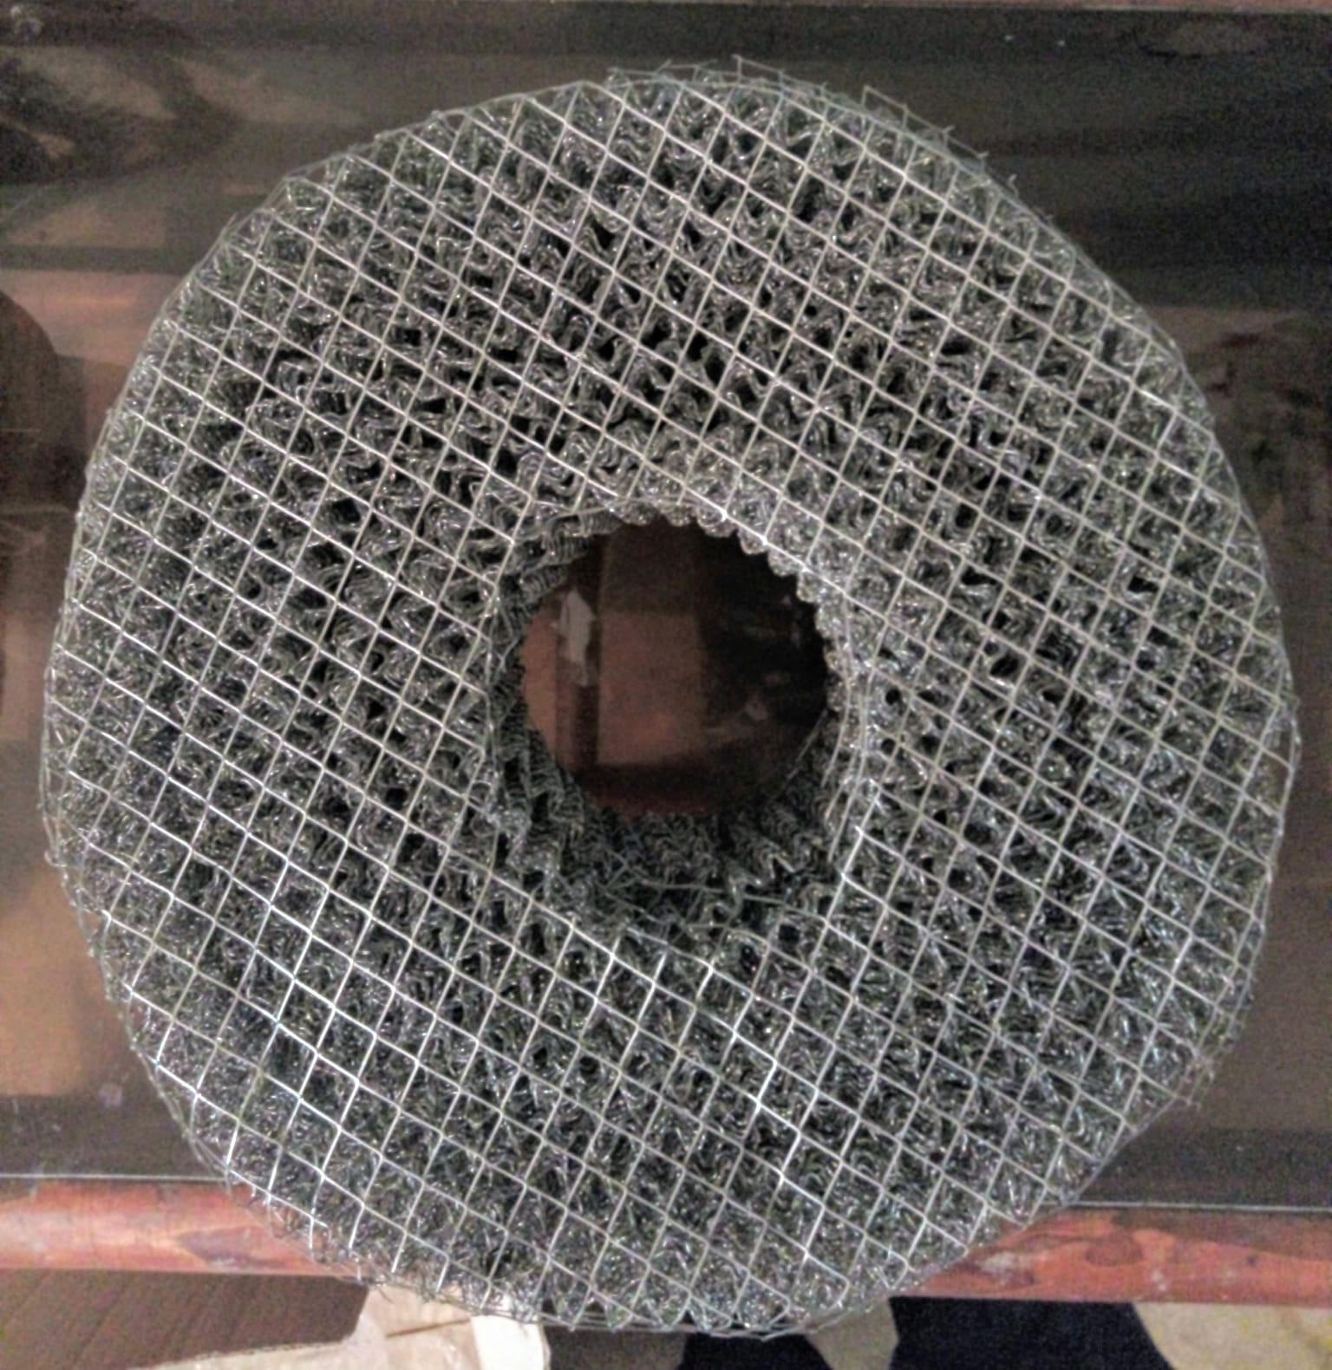
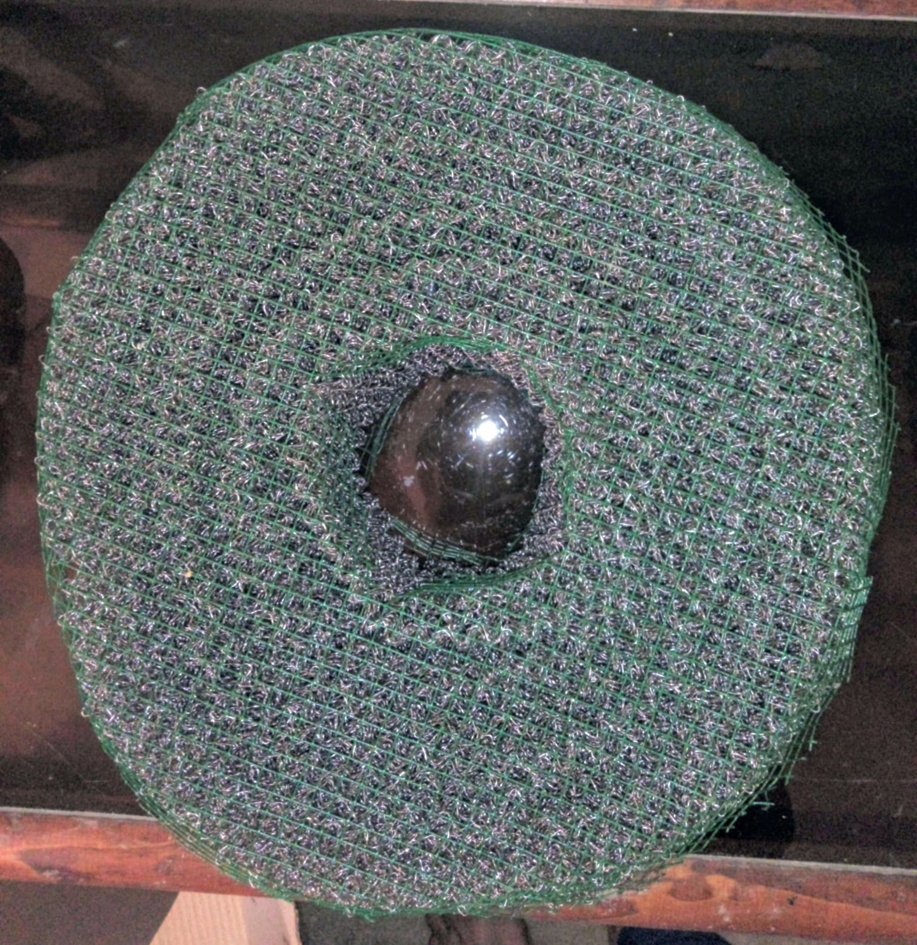
SBU

Slide 6
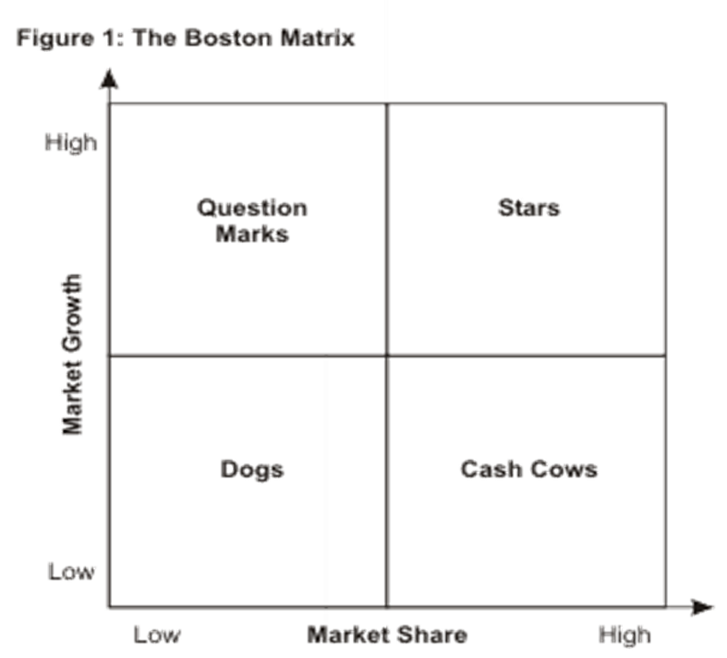
Bcg matrix (cash cow)
Our business is a cash cow, consistently producing strong cash flow, allowing us to reinvest in growth opportunities and support other business ventures.
With its established market position and loyal customer base, our cash cow business provides a reliable source of revenue, enabling financial stability and strategic expansion.
Our cash cow business continues to deliver substantial profits, requiring minimal resources for maintenance, which positions us favorably for long-term sustainability and diversification.

Slide 7
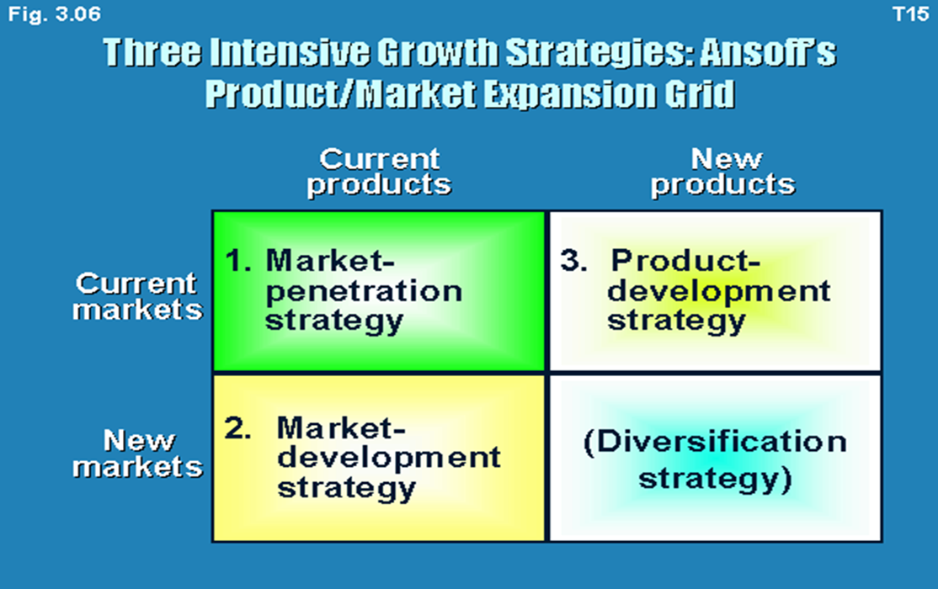
Market expansion grid
Expand Distribution: we will Identify and reach out to new distributors and retailers who can carry our air filters, potentially increasing our product's availability and visibility in the market.
Competitive Pricing: we will Evaluate our pricing strategy to ensure that our products are competitively priced, potentially attracting new customers and retaining existing ones.

Slide 8
4 P’s & 4 c’s
Product:
Product Diversification
Price:
Competitive Pricing
Place (Distribution):
Expand Distribution Channels
Promotion:
Sales Promotions
Customer Needs and Wants:
Understand our target market's needs
Cost to the Customer:
Consider not only the price of our air filters
Convenience:
Optimizing the availability of our products
Communication:
Establishing effective communication channels with our customers

Slide 9
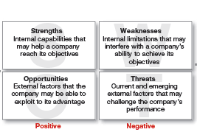
SWOT ANALYSIS
Strength:
Established Reputation for Quality
Weakness:
Limited Product Diversification
Opportunity:
Growing Market for Innovative Solutions
Threat:
Intense Competitive Landscape

Slide 10
Marketing implementations
Who: "Identifying the target audience, understanding their needs, and tailoring marketing efforts to engage and resonate with them is essential for success.“
Where: "Selecting the right marketing channels and platforms, both online and offline, to reach the target audience effectively and efficiently.“
When: "Timing is key, as launching marketing campaigns at the right moment can maximize their impact and response.“
How: "Developing a clear and well-executed strategy that outlines the specific tactics, messaging, and resources required to implement the marketing plan effectively."

Slide 11
Marketing control process
Set Goals: Clearly define specific and measurable marketing objectives that align with the overall business strategy.
Measure Performance: Establish and use key performance indicators (KPIs) to monitor and measure the results and outcomes of marketing initiatives.
Evaluate Performance: Compare the actual results and performance with the established goals and benchmarks to assess the effectiveness of marketing strategies.
Take Corrective Action: Based on the evaluation, make informed decisions and take corrective actions to address any deviations from the planned course and improve future marketing efforts.

